Slide 1
Risk happens
--- and formal methods can help
Enno Ruijters
Formal Methods & Tools

Slide 2
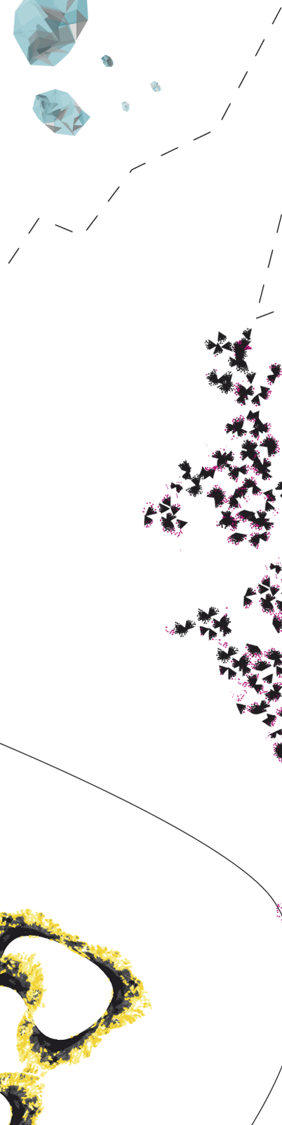
Introduction

Slide 3

No risk, no fun

Slide 4
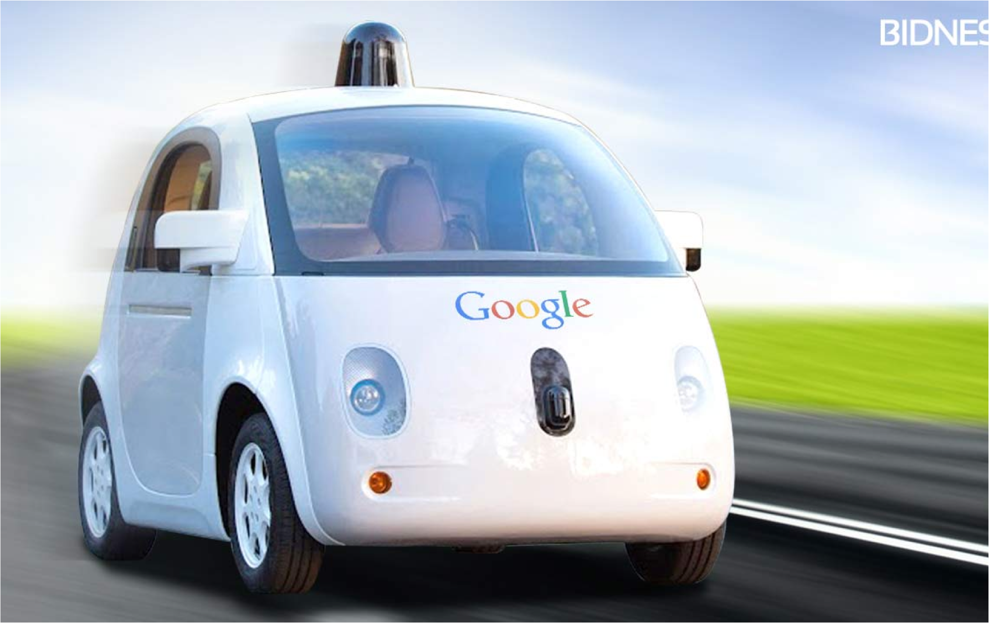
object detection
sensors
lasers
software
GPS
How to manage risks of (new) products & services?
Model risks
Analyze / prioritize
Take appropriate measures
Design space: improve safety (& security)
Better components | redundancy | fail-safe mechanisms | maintenance | testing | ….
→ Make better and more informed decisions

Slide 5
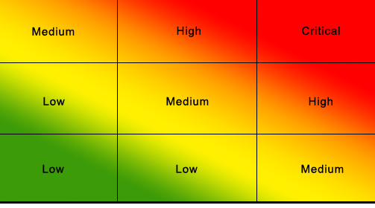
Risk priority heat map
Insure
driving license,
ad. cruise control
Speed limits
Airbags
Severity / impact
Accept risks
Probability

Slide 6
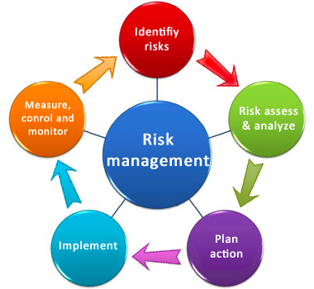
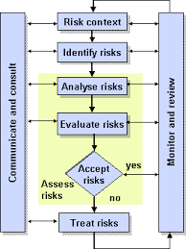
How to get the heat map?

Slide 7


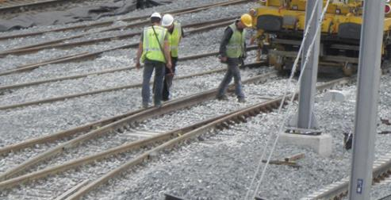
WHO AM I ?
2008 – 2014: Operations Research
Maastricht University
2014 – 2018
PhD Student: ArRangeer project
Formal Methods and Tools @ UTwente
Integrating maintenance in fault trees
Collaboration with ProRail and NedTrain
2018 – now
Postdoc @ Utwente
Software testing based on user actions

Slide 8
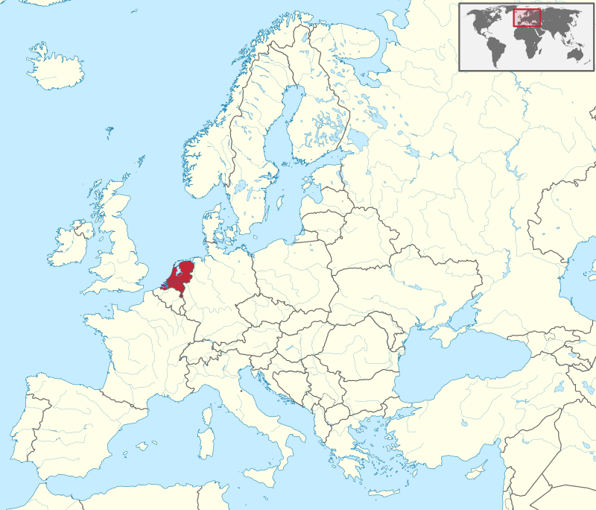

Slide 9
Risk management: engineering a safer world
Methods
Informal / Spread sheets:
  Failure Mode, Effect and Criticality Analysis (FMECA)
  Hazard & operability study (Hazop)
Architectural:
  UML/Marte,
  AADL
Domain-specific:
  Fault tree analysis
  Reliability block diagrams,
  Event trees
Formal Methods can help!
Risk assessment often mandatory
Standardization
NRC NUREG–0492: nuclear industry
SAE ARP4761: aerospace,
IEC standard: 61025
European NEN 61025.
Design alternatives
More redundancy
Hot / warm / cold spare components
More reliable components
Monitoring
Fail-safe mechanisms

Slide 10
Do things you could not do before
Use FME(C)A to get an overview of risks
Model & analyze risk quantitatively via fault trees
Calculate possible outcomes via event trees
Be fluent on probability theory
Theory + practice = fun!

Slide 11
Other quantitative methods
Not covered:
Financial models
Human factors analysis
  Aerospace, nuclear industries
Software reliability
Physics of failure
Plenty of others ☺

Slide 12
Overview
FME(C)A / HAZOP
qualitative
cut sets
standard
Risk
analysis
discrete
probability
quantitative
continuous
probability
FTs
qualitative
cut sequence
dynamic
discrete
probability
quantitative
continuous
probability

Slide 13


Slide 14
FME(C)A & HAZOP
Note: related to Attack Trees in security

Slide 15
Failure Mode and Effect Analysis
Spreadsheet based method
Enumerate all (single) failure modes and their effects
Different standard have different fields
Example (for this presentation):
Component | Failure mode | Effect
Projector | Lamp fails | Change rooms, delay
Computer | Does not start | Use different computer
Laser pointer | Empty batteries | Point manually
Presenter | Oversleeps | Late start

Slide 16
Failure Mode, Effect and Criticality Analysis
Extend FMEA with probability and severity:
Component | Failure mode | Effect | Prob. | Severity | Criticality
Beamer | Lamp fails | Change rooms, delay | Low | Medium | Low
Computer | Does not start | Use different computer | Medium | Medium | Medium
Laser pointer | Empty batteries | Point manually | High | Low | Medium
Presenter | Oversleeps | Late start | Low | High | Medium

Slide 17
Failure Mode and Effect Analysis
Other fields sometimes included:
  Function (of system and/or component)
  Failure cause
  Consequences of different types (e.g. cost, risk to public, reputation damage, etc.)
  Mitigation, residual effects
  Detection options
  Other internal fields (reporting codes, historic occurrence, etc.)

Slide 18
Failure Mode and Effect Analysis
More detailed example:
Component | Function | Failure mode | Failure cause | Local effect
Beamer | Show presentation | Blank screen | Lamp burnt out | No visuals
Computer | Show presentation | Does not start | Windows | No visuals
Laser pointer | Direct attention | Does not point | Batteries empty | Manual pointing
Presenter | Teach | Oversleeps | Alarm clock fails | Late start
Mitigation | Residual effect | Global effect
Change rooms | Delay | Students learn less
Use other computer | Delay | Students learn less
Use spare batteries | None | Presenter has tired arm
None | Late start | Students learn less

Slide 19
Failure Mode and Effect Analysis (Exercise)
Perform FMECA for a bicycle.
Fields:
  Component
  Function
  Failure mode
  Global effect
  Probability (high/medium/low)
  Severity (high/medium/low)
Find approx. 5 lines

Slide 20
Failure Mode and Effect Analysis
My FMECA:
Your answers may differ
Component | Function | Failure mode | Effect | Prob. | Severity
Tire(s) | Smooth ride | Puncture | Bumpy ride | High | Medium
Brake(s) | Slow down | Cable severed | Accident | Low | High
Lamp | Draw attention, avoid fines | Burnt out bulb | No cycling in dark | Medium | Medium
Bell | Draw attention | Broken clapper | Stuck behind slower traffic | Medium | Low
Chain | Speed up | Slipped off gear | Stopped until fixed | High | Medium
Chain | Speed up | Broken link | Stopped until replaced | Low | High

Slide 21
Hazard and operability study (HAZOP)
Similar to FME(C)A.
Commonly used in chemical industry
Systematic method to enumerate failure modes using guide words
List of possible components:
  Cooling, heating, power, reactants, etc.
List of possible conditions:
  Too much, not enough, incorrect, etc.
Identify all applicable combinations

Slide 22
Hazard and operability study (HAZOP)
Example (baking bread):
Condition | Component | Effect | Etc.
Not enough | Flour | Crumbly bread
Too much | Flour | Very dense bread
Not enough | Heating | Raw dough in bread
Too much | Heating | Burnt bread
Too fast | Heating | Burnt crust and raw dough

Slide 24
fault trees
Note: related to Attack Trees in security

Slide 25
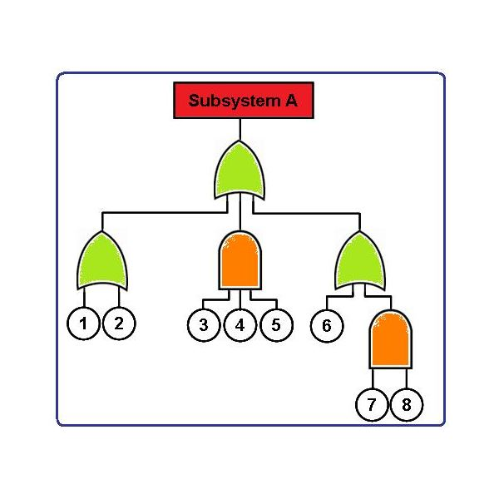
Fault trees: what are they?
Tool in reliability engineering
Graphical Model
  Tell how systems fail:
  How do component failures lead to system failures?
Qualitative Analysis
  Pinpoint root causes / critical parts
Quantitative Analysis: metrics
  Reliability: P[no failure during mission time]
  Availability: E[up-time]
  MTTF
  …
Read more?
Overview state-of-the-art modeling, analysis, tools
> 150 FT papers

Slide 26















fault trees: who uses them?

Slide 27
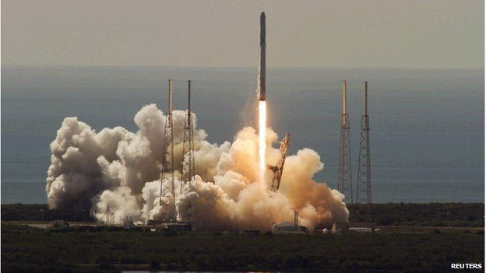
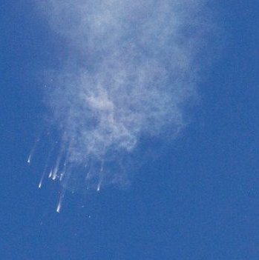
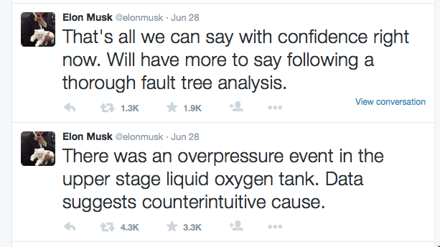

FTA on twitter
Falcon 7 rocked, SpaceX
Led by Elon Musk, Tesla
Ready for launch June 2015

Slide 28
Fault trees
Describe how component failures interact.
Building blocks:
Start with undesired event and repeatedly break down into possible causes.
2/5
Basic event
Or gate
AND gate
VOTING gate

Slide 29

Example: Safe road trip
road trip fails
phone
car
power
tires
connection
2/5
battery
engine
tire 1
tire 2
tire 3
tire 4
spare
Cut sets: Which BEs make FT fail?
{battery, engine, tire 1, spare}
{connection, tire 1, spare} minimal cut set
{no connection, engine} minimal cut set

Slide 30
(Minimal) cut sets
Cut set
Set of basic events C that cause the FT to fail
Minimal cut sets
Cut set that is minimal, ie no proper subset of C is cut set
Use of minimal cut sets
Validation of fault trees
  If all BEs in C fail, should the system fail?
Identify weak points:
  too small cut sets
  Interpretation by experts: is this acceptable?

Slide 31
The fault tree model: semantics
Structure function Φ: {0,1}^{#BEs} → {0,1}
1 = fail; 0 = operational
Given values e₁, …e_{n}, does F fail?
π_{F}: P(BE) → {0,1}
If BEs e₁, …e_{n} fail, does F fail?
π_{F}: P(BE) x Elt → {0,1}
If BEs e₁, …e_{n} fail, does e fail?
Recursive characterization
  AND-case: π_{F}(E,e) = 1 iff π_{F}(E,e’) = 1 for all children e’ of e
  … etc ..
Cut set : Set of basic events C that cause FT to fail: π_{F}(C) = 1
  FTs are coherent:
    S ≤ S’ & π_{F}(S)= 1 ➔ π_{F}(S’) = 1
    Non-coherent extensions exist (eg NOT, XOR gate)
road trip
e
e₁
e₂
e_{n}

Slide 32

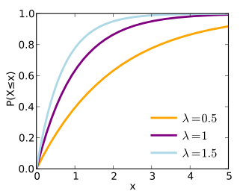
Exponential probability distribution
Components fail with fixed rate / time
Unreliability / CDF =
P[fail before x] =
P[X ≤ x] = 1 − e^{−λx}
Reliability =
P[no fail before x] =
P[X > x] = e^{−λx}
PDF
f(x) = F’(x) = λe^{−λx}
Who is afraid of
probability theory?

Slide 33

How to determine system reliability?
= probability of no failure during mission time

Slide 34
Quiz question #1: determine unreliability / failure probability
(p₁ + p₂ - p₁p₂)p₃ +
p₁(1 – ((1-p₄)⁵ + 5p₄(1-p₄)⁴)(1-p₃)
road trip
??
car
phone
1 – (1-p₃)((1-p₄)⁵ + 5p₄(1-p₄)⁴)
p₁ + p₂p₃ - p₁p₂p₃
1 – (1-p₄)⁵ – 5p₄(1-p₄)⁴
connection
power
tires
p₂p₃
p₁
2/5
battery
engine
tire 1
tire 2
tire 3
tire 4
spare
p₂
p₃
p₄
p₄
p₄
p₄
p₄
P[A v B ] = P[A] + P[B] – P[A&B]
P[A & B ] = P[A] P[B], A, B indep
P[B^{C}] = 1 – P[B]
P[A ] = P[A | B] P[B] + P[A|B^{C}] P[B^{C}]

Slide 35
Speed up #1: discard (higher order) products
(p₁ + p₂ - p₁p₂)p₃ +
p₁(1 – ((1-p₄)⁵ + 5p₄(1-p₄)⁴))(1-p₃)
road trip
??
(p₁+p₂ - p₁p₂)p₃
p₁(1 – ((1-p₄)⁵ + 5p₄(1-p₄)⁴)) (1-p₃)
car
phone
1 – (1-p₃)((1-p₄)⁵ + 5p₄(1-p₄)⁴)
p₁ + p₂p₃ - p₁p₂p₃
p₁+p₂ - p₁p₂
p₁
1
1 – ((1-p₄)⁵ + 5p₄(1-p₄)⁴)
1 – (1-p₄)⁵ – 5p₄(1-p₄)⁴
connection
power
tires
p₂p₃
p₁
2/5
battery
engine
tire 1
tire 2
tire 3
tire 4
spare
p₂
p₃
p₄
p₄
p₄
p₄
p₄
Case 1: engine fails; p₃=1
Case 2: engine does not fail; p₃=0
P[A ] = P[A | B] P[B] + P[A|B^{C}] P[B^{C}]

Slide 36
Quiz question #2:
Find 3 ways to speed up this computation

Slide 37
Simplify the computation
Disregard higher order products
Use minimal cut sets
Combine 1 & 2
Use BDDs

Slide 38
Speed up #1: discard (higher order) products
(p₁ + p₂ - p₁p₂)p₃ +
p₁(1 – ((1-p₄)⁵ + 5p₄(1-p₄)⁴)(1-p₃)
road trip
??
p₁+ p₃
p₁
car
phone
1 – (1-p₃)((1-p₄)⁵ + 5p₄(1-p₄)⁴)
p₁ + p₂p₃ - p₁p₂p₃
p₃
0
1 – (1-p₄)⁵ – 5p₄(1-p₄)⁴
connection
power
tires
p₂p₃
p₁
2/5
5p₄– 5p₄ = 0
battery
engine
tire 1
tire 2
tire 3
tire 4
spare
p₂
p₃
p₄
p₄
p₄
p₄
p₄
1 – (1-p₄)⁵ < 5p₄

Slide 39
Speed up #2 & 3: Using cut sets
Min cut set | prob
connection, engine | p₁ * p₃
battery, engine | p₂ * p₃
connection, t1, t2 | p₁ * p₄²
connection, t1, t3 | p₁ * p₄²
connection t1, t4 | p₁ * p₄²
connection t1, spare | p₁ * p₄²
connection t2, t3 | p₁ * p₄²
connection t2, t4 | p₁ * p₄²
connection t2, spare | p₁ * p₄²
connection t3, t4 | p₁ * p₄²
connection t3, spare | p₁ * p₄²
connection t4, spare | p₁ * p₄²
TOTAL | p₁*p₃ + p₂*p₃ + 10* p₁ * p₄²
Under- or overapproximation? Why?
P[C₁ v C₂ v C₃ ] =
P[C₁] + P[C₂] + P[C₃]
- P[C₁]P[C₂] - P[C₁]P[C₂] - P[C₂]P[C₂]
+ P[C₁] P[C₂] P[C₃] ≤
P[C₁] + P[C₂] + P[C₃]
(p₁ + p₂ - p₁p₂)p₃ +
p₁(1 – ((1-p₄)⁵ + 5p₄(1-p₄)⁴)(1-p₃)
road trip
Combine with #3
phone
car
connection
power
tires
p₁
2/5
battery
engine
tire 1
tire 2
tire 3
tire 4
spare
Note: p₁ , p₄
should be low
p₂
p₃
p₄
p₄
p₄
p₄
p₄

Slide 40
Speed up #2 & 3: Using BDDs
BDDs
Compact representation for Boolean functions f(x₁,x₂,….,x_{n})
  eg the structure function of a FT
Heavily used in model checking
  (intial) condition
  (reachable) state space
Based on Shannon expansion / pivotal decomposition
  f(x₁,x₂,….,x_{n}) = x₁f(0,x₂,….,x_{n}) + x₁f(1,x₂,….,x_{n})
  fixed variable ordering
  shared subtrees

Slide 41
Example: (x₁ OR x₂) AND x₃
Truth Table
Decision Tree
x₁ | x₂ | x₃ | f(x₁,x₂,x₃)
0 | 0 | 0 | 0
0 | 0 | 1 | 0
0 | 1 | 0 | 0
0 | 1 | 1 | 1
1 | 0 | 0 | 0
1 | 0 | 1 | 1
1 | 1 | 0 | 0
1 | 1 | 1 | 1
x₁
x₂
x₂
x₃
x₃
x₃
x₃
0
0
0
1
0
1
0
1
  Vertex represents decision
  Follow dashed line for value 0
  Follow solid line for value 1
  Function value in leave.

Slide 42
Example: (x₁ OR x₂) AND x₃
Variables ordered
x₁ < x₂ < x₃
x₁
(no OR x₂) AND x₃ = x₂ AND x₃
(yes OR x₂) AND x₃ = x₃
x₂
x₂
no AND x₃ = no
yes AND x₃ = x₃
x₃
x₃
x₃
x₃
x₃
x₃
0
0
0
1
0
1
0
1

Slide 43
Example: (x₁ OR x₂) AND x₃
Variables ordered
x₁ < x₂ < x₃
x₁
x₂
x₂
x₃
x₃
x₃
x₃
0
1

Slide 44
Example: (x₁ OR x₂) AND x₃
x₁
Variables ordered
x₁ < x₂ <….,< x_{n}
x₁ = 0
x₁ = 1
x₂
Size of BDDs heavily
depends on variable order
x₁ < x₂ <….,< x_{n}
Finding best order is
NP hard
Good algos in practice
x₃
0
1
function value at leaves

Slide 45
Using BDDs
(connection + battery ) & engine
connection
1-p₁
p₁
battery
road trip
p₂
engine
p₃
phone
car
0
1
p₃p₁ + p₃p₂(1-p₁)
connection
power
tires
p₁
2/5
BDDs also find MCS
battery
engine
tire 1
tire 2
tire 3
tire 4
spare
p₂
p₃
p₄
p₄
p₄
p₄
p₄

Slide 46
Event trees

Slide 47
Event trees
Describe possible consequences of events.
Quantitative if probabilities known
Process:
  Start with initiating event.
  Determine possible immediate consequences.
  Examine what decides which consequences occur.
  Repeat

Slide 48
Event trees (example)
Firefighters arrive quickly
Building somewhat damaged
Building occupied
Firefighters arrive slowly
Deaths
Fire
Building not occupied
Building severely damaged

Slide 49
Event trees quantification
Assign probabilities to conditions
Firefighters arrive quickly
Building somewhat damaged
90%
Building occupied
60%
Firefighters arrive slowly
Deaths
Fire
10%
Building not occupied
Building severely damaged
40%

Slide 50
Event trees quantification
Compute probabilities of outcomes
Firefighters arrive quickly
Building somewhat damaged
90%
0.6 x 0.9 = 0.54
Building occupied
60%
Firefighters arrive slowly
Deaths
Fire
10%
0.6 x 0.1 = 0.06
Building not occupied
Building severely damaged
40%
0.4

Slide 51
Event trees quantification
Assign impact and compute risk
Firefighters arrive quickly
Building somewhat damaged
90%
0.6 x 0.9 = 0.54
€50,000
Building occupied
60%
Firefighters arrive slowly
Deaths
Fire
10%
0.6 x 0.1 = 0.06
€10,000,000
Building not occupied
Building severely damaged
40%
0.4
€500,000
0.54 x 50,000 + 0.06 * 10,000,000 + 0.4 * 500,000 = €827,000
If a fire occurs

Slide 52
Bow-tie diagram
Combine fault tree and event tree
  Use fault tree to analyze occurrence of initiating event.
  Use event tree to analyze consequences of event.

Slide 53
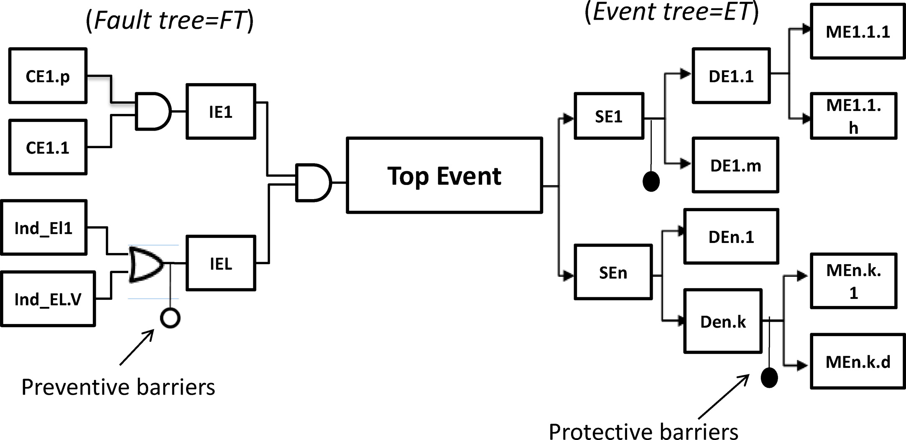
Bow-tie diagram (example)

Slide 54
fault trees in continuous time

Slide 55
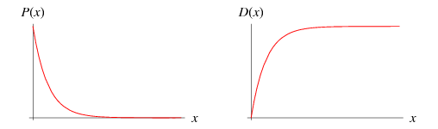
System (un)reliability
Unreliability
  U(t) = P[failure before time t]
Reliability / Survivor function
  R(t) = P[no failure until time t]
  = 1- U(t)
U(t)
t

Slide 56
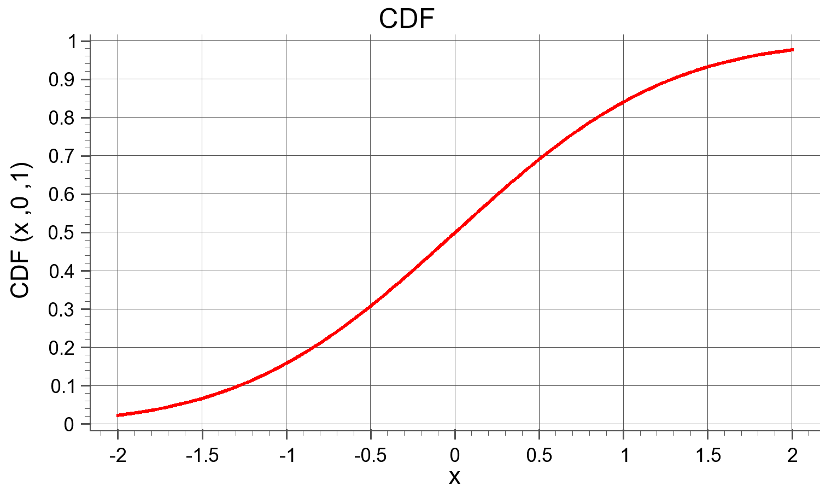
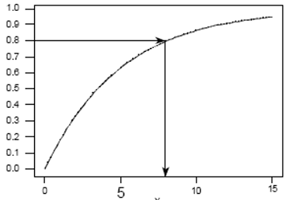
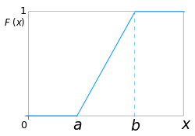
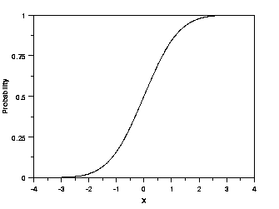

Continuous probability: failure behaviour over time
road trip
phone
car
connection
power
tires
2/5
battery
engine
tire 1
tire 2
tire 3
tire 4
spare

Slide 57
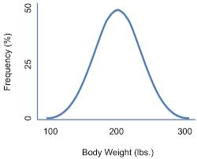
Continuous probability distributions: which one?
Uniform distribution
Gaussian
Exponential
  realistic model for degradation
  mathematically tractable
  approximation via composed exponentials
Weibull
  generalized exponential
  often used
  not discussed

Slide 58
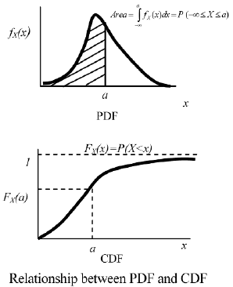
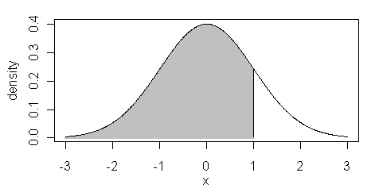
Repap: Continuous probability distributions
Often: P[X = x] = 0
Hence: F(x) = P[X ≤ x]
P[x ≤ X ≤ y] = P[X ≤ y] – P[X>x]
Where does the probability increase most?
  f(x) = F’(x)
  Then F(x) = the area under the graph

Slide 59
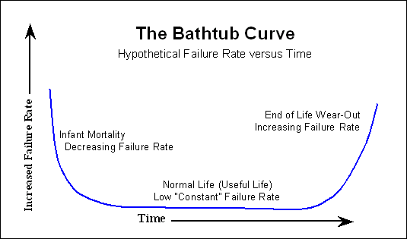
Bath tub curve: degradation behaviour of systems
exponential

Slide 60
Exponential probability distribution
Components fail with fixed rate / time
Unreliability / CDF =
P[fail before x] =
P[X ≤ x] = 1 − e^{−λx}
Reliability =
P[fail before x] =
P[X > x] = e^{−λx}
PDF
f(x) = F’(x) = λe^{−λx}
Exponential is a fundamental probability distribution

Slide 61
Show some known facts about exponential distributions

Slide 62

(on average)

Slide 63
Question
You are waiting in front of your professor’s office. There is a note on the door
      Back in Exp(1/15) minutes
Questions
What is the probability that you wait
  less than 5 minutes?
  more than 10 minutes?
  exactly 10 minutes?
  between 10 and 25 minutes?
What is the expected amount you have to wait?
You have been waiting for 15 minutes
  What is the probability that you still have to wait less than 5 minutes?
  What is the probability that you still have to wait more than 10 minutes?
  exactly 10 minutes?
  between 10 and 25 minutes?
Reminder:
P[X ≤ x] = 1 − e^{−λx}

Slide 64
Question
You are waiting in front of your professor’s office. There is a note on the door
      Back in Exp(1/15) minutes.
      X denotes your waiting time. Then X~ Exp(1/15)
Questions
What is the probability that you wait
  less than 5 minutes? P[X < 5] = 1 − e^{−5/15}
  more than 10 minutes? P[X > 10] = e^{−10/15}
  exactly 10 minutes? P[X = 10] = 0
  between 10 and 25 minutes? P[10 < X < 25] = P[X < 25] – P[ X < 10] =
  1 − e^{−25/15} - (1− e^{−10/15}) = − e^{−25/15} + e^{−10/15}
What is the expected amount you have to wait? E[X] = 15

Slide 65
Question
You are waiting in front of your professor’s office. There is a note on the door
      Back in Exp(1/15) minutes.
      X denotes your waiting time. Then X~ Exp(1/15)
Questions
You have been waiting for 15 minutes
  What is the probability that you have to wait more than 10 minutes?
  P[ X > 25 | X > 15 ] =
  P[ X > 25 & X > 15 ] / P[ X > 15 ] =
  P[ X > 25 ] / P[ X > 15 ] =
  e^{−25/15} / e^{−15/15} = {use eªe^{b} = e^{a+b}}
  e^{−25/15 +15/15} =
  e^{−10/15} =
  P[ X > 10]
  Exponential distribution memoryless: past waiting time has not influence on future waiting time
  Note: can be approximated with a dice

Slide 66
Question
You are waiting in front of your professor’s office. There is a note on the door
      Back in Exp(1/15) minutes.
      X denotes your waiting time. Then X~ Exp(1/15)
Questions
3. You have been waiting for 15 minutes
  What is the probability that you have to wait less than 5 minutes? 1 − e^{−5/15}
  What is the probability that you have to wait more than 10 minutes? e^{−10/15}
  exactly 10 minutes? P[X > 10] = 0
  between 10 and 25 minutes? − e^{−25/15} + e^{−10/15}

Slide 67
Example: probabilistic analysis
(p₁ + p₂ - p₁p₂)p₃ +
p₁(1 – ((1-p₄)⁵ + 5p₄(1-p₄)⁴)(1-p₃)
road trip
??
phone
car
connection
power
tires
λ₁
2/5
battery
engine
tire 1
tire 2
tire 3
tire 4
spare
λ₂
λ₃
λ₄
λ₄
λ₄
λ₄
λ₄
((1-e^{−λ1x}) +
+ (1-e^{−λ2x}) - (1-e^{−λ1x}) (1-e^{−λ2x})) (1-e^{−λ3x})
+
(1-e^{−λ1x})(1 – (e^{−λ4x})⁵ + 5(e^{−λ4x}) e^{−λ4x4})e^{−λ3x}
Hint: If you’re smart, this can be fast

Slide 68
Dynamic fault trees

Slide 69
Dynamic fault trees: Safe road trip
road trip
phone
car
connection
power
tires
battery
engine
tire 1
tire 2
tire 3
tire 4
spare
Spares have reduced failure rates

Slide 70
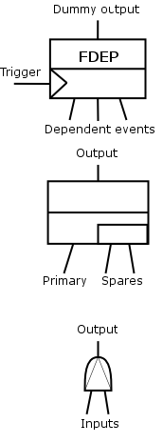
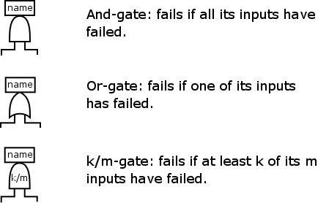
DFTs gates
static:
dynamic: failure order matters
AND
FDEP
OR
SPARE
(k,m)
VOTING
Previous restrictions
spare inputs: BEs
dep. events: BEs
PAND

Slide 71
Dynamic fault trees: Qualitative analysis
road trip
phone
car
connection
power
tires
battery
engine
Cut sets:
tire 1
tire 2
tire 3
tire 4
spare
{Connection, engine}?
Yes, but order now matters

Slide 72
Dynamic fault trees: Qualitative analysis
road trip
phone
car
connection
power
tires
battery
engine
Cut sequences:
tire 1
tire 2
tire 3
tire 4
spare
(Connection, engine)?
Need to consider negatives: (tire 1, tire 2, connection, engine)

Slide 73
Fault tolerant parallel processors (FTPP)
A
B
C
S
NE1
A
A
B
B
N
E
2
N
E
4
C
C
S
S
NE3
A
B
C
S
Set up
4 types of processors available A, B, C, S
  Group S is a spare group
Connected via Network Elements
  If NE unavailable, all processors attached are unavailable
Requirement
for each type, at least 3 processors available
Question
Construct a (D)FT for this

Slide 74
Fault tolerant parallel processors (FTPP)
A
B
C
S
NE1
A
A
B
B
Requirement
for each type A, B, C
at least 3 processors available
N
E
2
N
E
4
C
C
S
S
System Failure
NE3
A
B
C
S
OR
Group A Failure
Group B Failure
Group C Failure
Group 1P Failure
Group 2P Failure
Group 3P Failure
Group 4 Failure
2/4
2/4
2/4
2/4
A₁
A₂
A₃
A₄
B₁
B₂
B₃
B₄
C₁
C₂
C₃
C₄
S₁
S₂
S₃
S₄
NE1
FDEP
NE2
FDEP
NE3
FDEP
NE4
FDEP
A₁
B₁
C₁
S₁
A₂
B₂
C₂
S₂
A₃
B₃
C₃
S₃
A₄
B₄
C₄
S₄

Slide 75
Fault tolerant parallel processors (FTPP)
A
B
C
D
NE1
A
A
B
B
Requirement
for each type A, B, C
at least 3 processors available
N
E
2
N
E
4
C
C
D
D
System Failure
NE3
A
B
C
D
OR
Group A Failure
Group B Failure
Group C Failure
2/4
2/4
2/4
A₁
A₂
A₃
A₄
B₁
B₂
B₃
B₄
C₁
C₂
C₃
C₄
D₁
D₂
D₃
D₄
NE1
FDEP
NE2
FDEP
NE3
FDEP
NE4
FDEP
A₁
B₁
C₁
D₁
A₂
B₂
C₂
D₂
A₃
B₃
C₃
D₃
A₄
B₄
C₄
D₄

Slide 76
Fault tolerant parallel processors (FTPP)
A
B
C
D
NE1
A
A
B
B
N
E
2
N
E
4
C
C
D
D
NE3
System Failure
A
B
C
D
OR
Group 1 Failure
Group 2 Failure
Group 3 Failure
Group 4 Failure
2/4
2/4
2/4
2/4
OR
OR
OR
OR
OR
OR
OR
OR
OR
OR
OR
OR
OR
OR
OR
OR
A₁
A₂
A₃
A₄
B₁
B₂
B₃
B₄
C₁
C₂
C₃
C₄
D₁
D₂
D₃
D₄
NE1
NE2
NE3
NE4

Slide 77
Dynamic fault trees: pitfalls
Simultaneous failures and PANDs:
Semi-spare nodes

Slide 78
Dynamic fault trees: Quantitative analysis
Original method: Markov chains

Slide 79
Dynamic fault trees: Analysis
road trip
Draw the Markov chain for
this simplified DFT.
phone
car
connection
power
tires
battery
engine
tire 1
spare

Slide 80
Dynamic fault trees: Solution
road trip
phone
car
connection
power
tires
battery
engine
tire 1
spare

Slide 81
Fault tree analysis: how to compute reliability?
fail
Failure
A
B
C
S
Notes:
Pijlen met vertaling en compositie

Slide 82
Deep compositionality [IEEE TDSC’10]
Translation
Composition
+ hiding
1325 states
instead of
32757 states
Order matters
(size only!)
Repeat
minimization
Analysis
Result:
unreliability
MC generation
= P[failure
during mission time]
CTMC / CTMDP
Notes:
Animation!

Slide 83
Interactive Markov Chains (I/O-IMC)
I/O-Automata + CTMC
Markovian transitions (CTMC)
  labeled with rates λ
  delays governed by exponential distribution
  P[transition within t sec] = 1 – e^{-λ t}
Interactive transitions (I/O)
  labeled with actions
  synchronization
Action signature
  ? - Input actions: delayable
  ! - Output actions: immediate
  ; - Internal actions: immediate
Recent work: discrete probabilty + costs
act?
Warm BE: can
fail before
activation,
with reduced rate
μ
I/O-IMC for
cold
basic event
λ
fail!
fail!

Slide 84
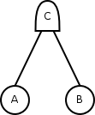
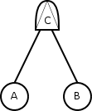
Question: I/O-IMC semantics for DFT gates
AND gate
fail(A)?
fail(B)?
fail(C)!
fail(B)?
fail(A)?
PAND gate
fail(A)?
fail(B)?
fail(C)!
fail(B)?
Similar, but more complex for other gates

Slide 85
Tool implementation: DFTcalc
DFTCalc
Metrics
Translation
Analysis
Efficiency:
Compositional aggregation
Context-dependent state space generation

Slide 86
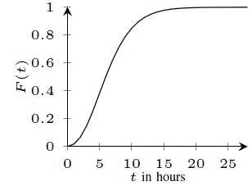
Challenge: state space explosion
stochastic
(Markov)
models
Results:
reliability
availability
costs
strategy
diagnostics, …
Graph transformations
flatten ANDs, OR…
Reductions:
lumping
confluence
abstraction
….

Slide 88
Case studies
& maintenance

Slide 89
Integrating maintenance
Two new elements:
  Rate-dependency gate:
  Basic events with degradation and repairs:

Slide 90
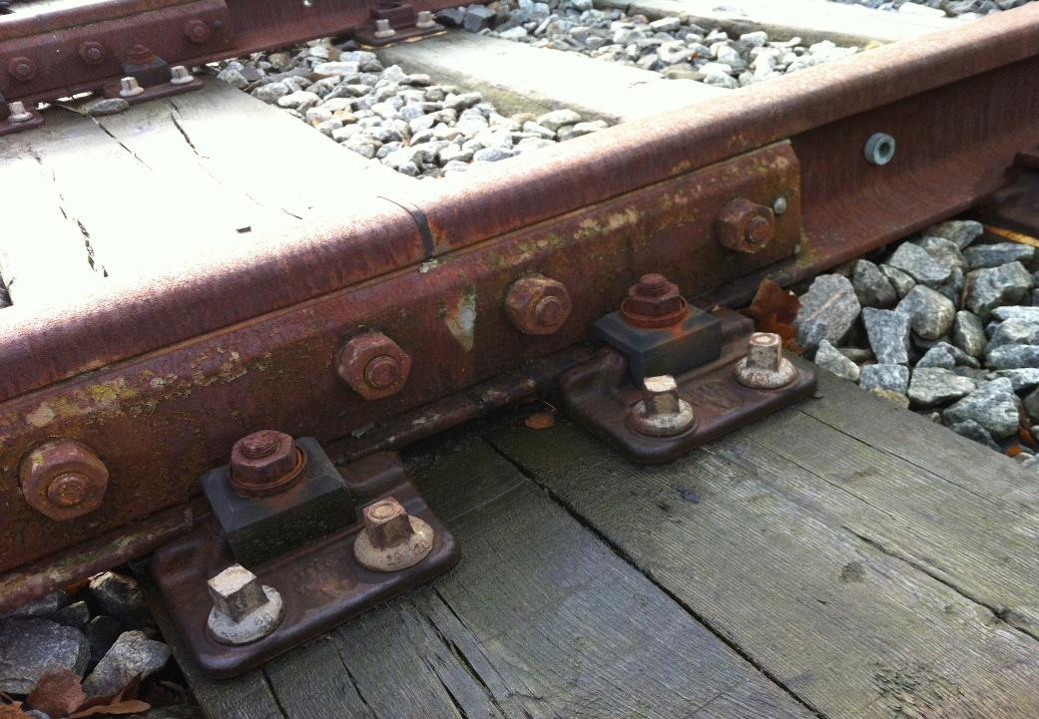
Case 1: Electrically Insulated Joint
Electrically separates tracks
45.000 EIJs in the Netherlands
Important cause of train disruptions

Slide 91
Case 1: Electrically Insulated Joint

Slide 92
Case 1: Electrically Insulated Joint (results)

Slide 93
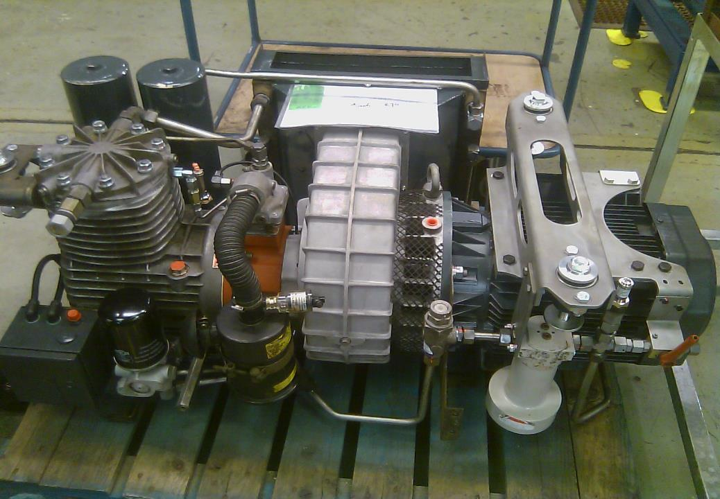

Case 2: Pneumatic compressor
Powers brakes, doors, etc.
Fail-safe but failures cause disruptions
Maintenance is essential for normal operation

Slide 94
Case 2: Pneumatic compressor

Slide 95
Case 2: Pneumatic compressor (results)

Slide 96
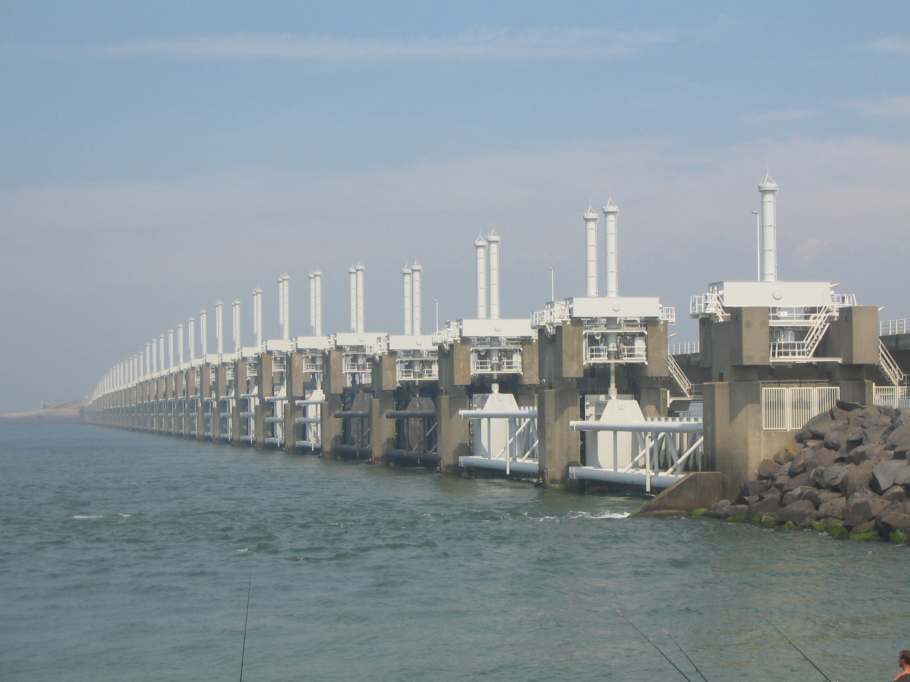

Case 3: Oosterscheldekering
existing FT
  FT contains 1000’s of gates
  Leaves: spare part handeling
current strategy meets requirements

